Slide 1
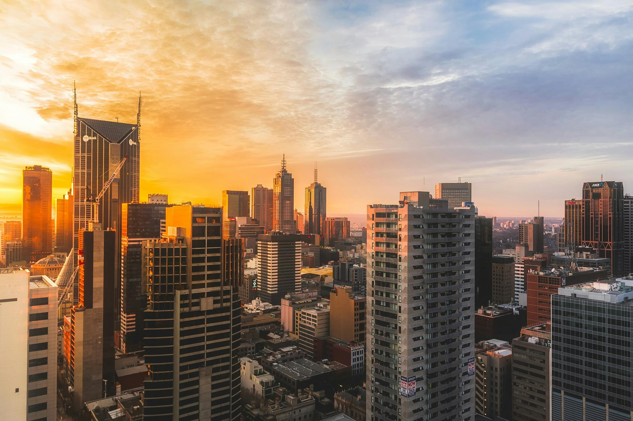
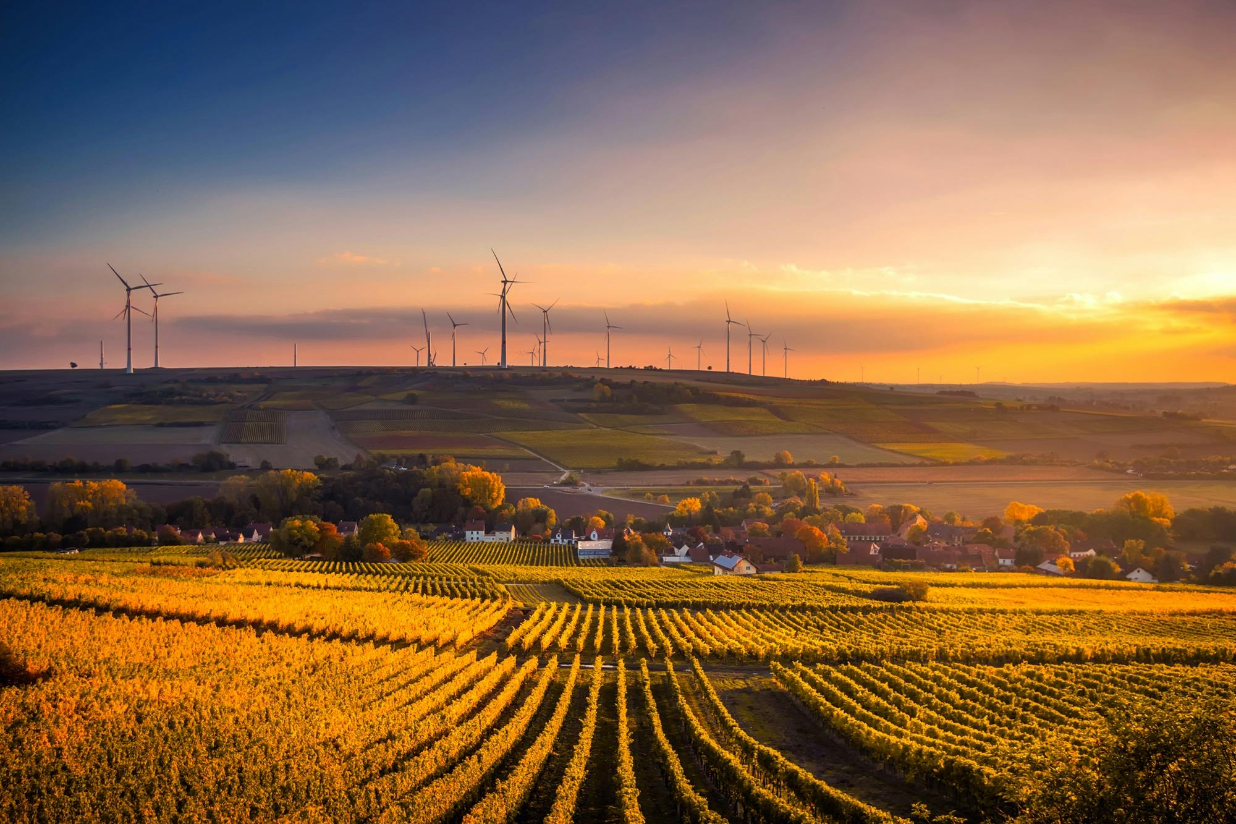

Name: Muhammad Amaz Majeed
Class: SE25-1A
Roll NO: 048

Slide 2
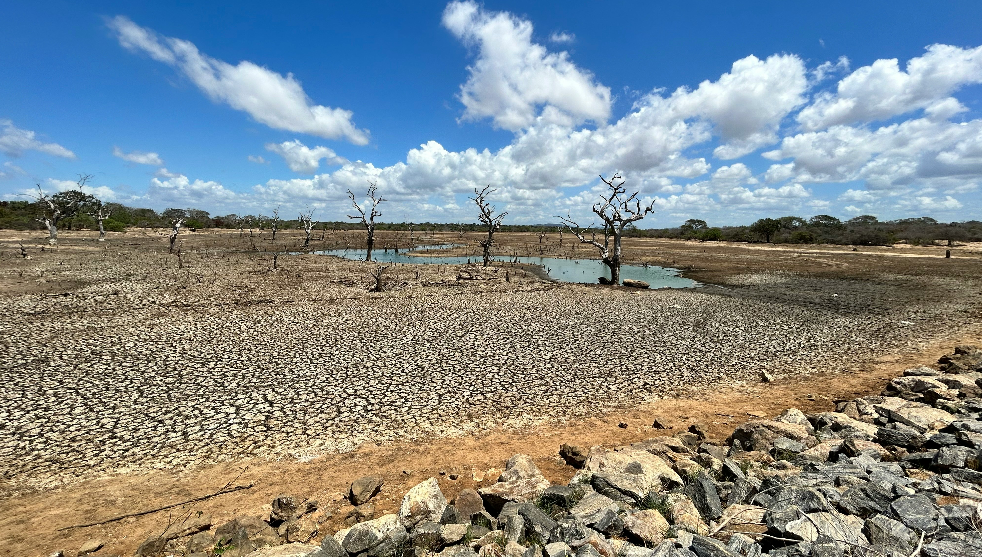
Global
Focusing on a specific region facing critical Shortages.

Slide 3
The Scale of the Crisis
2.2B
People lack access to safely managed drinking water.
By 2030, global water demand is projected to exceed supply by 40%. Scarcity is no longer a distant threat—it is a present reality for one-third of the global population.

Slide 4



Primary Drivers of Scarcity
Population Growth
Rapid urbanization and population expansion place unsustainable pressure on finite municipal water systems.
Climate Change
Pollution
Shifting weather patterns are causing more frequent and prolonged droughts, disrupting historical rainfall cycles.
Industrial runoff and poor sanitation contaminate available freshwater sources, further reducing supply.

Slide 5
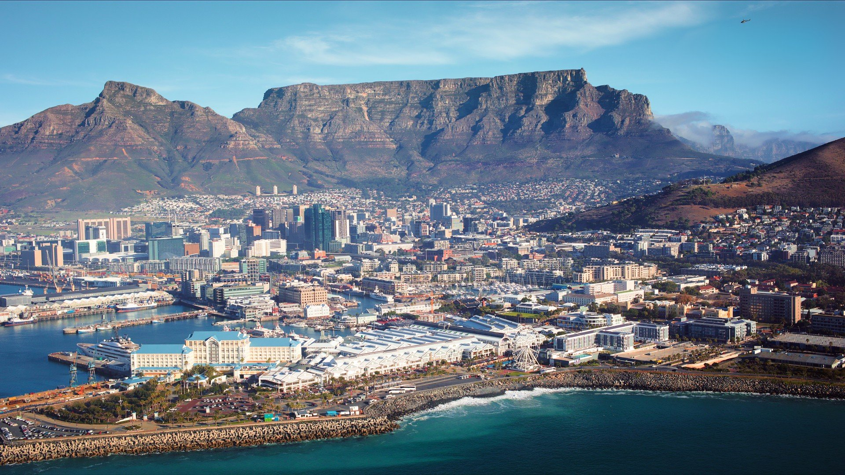
Case Study: Cape Town
The "Day Zero" Crisis
In 2018, Cape Town faced the unthinkable: becoming the first major city in the modern world to completely run out of water.
A 1-in-400 year drought, combined with administrative oversight, brought the city's dams to critically low levels.

Slide 7
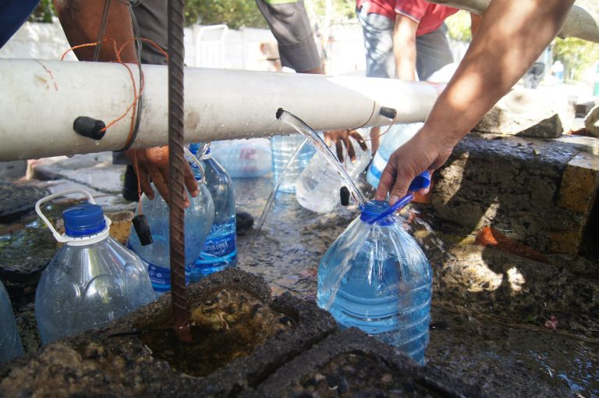
The Reality: 50 Liters per Day
Severe Restrictions
As "Day Zero" approached-the day taps would be turned off-residents were strictly limited to 50 liters of water per person per day.
Showers were limited to 90 seconds.
Greywater was reused for flushing toilets.
Residents queued at natural springs to stockpile water, fearing the collapse of the municipal grid.

Slide 8
Crisis Averted: Usage Drop
Pre-Crisis:
1200 ML/Day
Crisis Target:
500 ML/Day
Actual Low(2018):
520 ML/ DAY
Through collective effort, Cape Town reduced its daily consumption by nearly 60% in record time, effectively pushing back Day Zero until the rains returned.

Slide 9
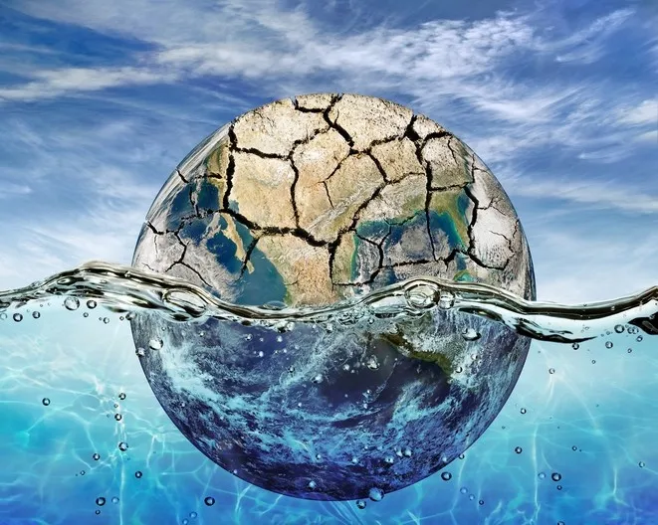
Global Lessons
Diversify Sources
Value Water
Data Is the Key

Slide 10
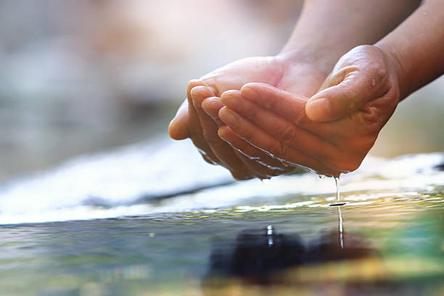
A Water-Secure Future
Cape Town's story is both a warning and a roadmap. As the climate changes, proactive management, innovation, and respect for our most precious resource are the only path forward

Slide 11
THANK U!!

